Slide 1

Foreign Direct Investment Analysis

Slide 2
Introduction
Foreign Direct Investment (FDI) is the investment made by a company or individual from one country into business interests located in another country.
This type of investment typically involves acquiring a significant degree of influence or control over the foreign business.
It plays a vital role in boosting economic growth, creating employment opportunities, transferring technology and skills, Access to new market , increased competition and Diversification.

Slide 3
Data overview
The dataset, contains historical data on Foreign Direct Investment (FDI) in various sectors in India from 2000 to 2017. It offers insights into the flow of FDI into different sectors such as Metallurgical Industries, Power, Telecommunications, Automobile Industry, Chemicals, and many more.
Identifying the sectors that attract the most investment and the trends over time.
It serves as a key resource for economic progress and policy making.

Slide 4

Key metrics
Total investment by Year
Total investment by sector
Top 5 sectors
Bottom 5 sectors
Flow of investment

Slide 5
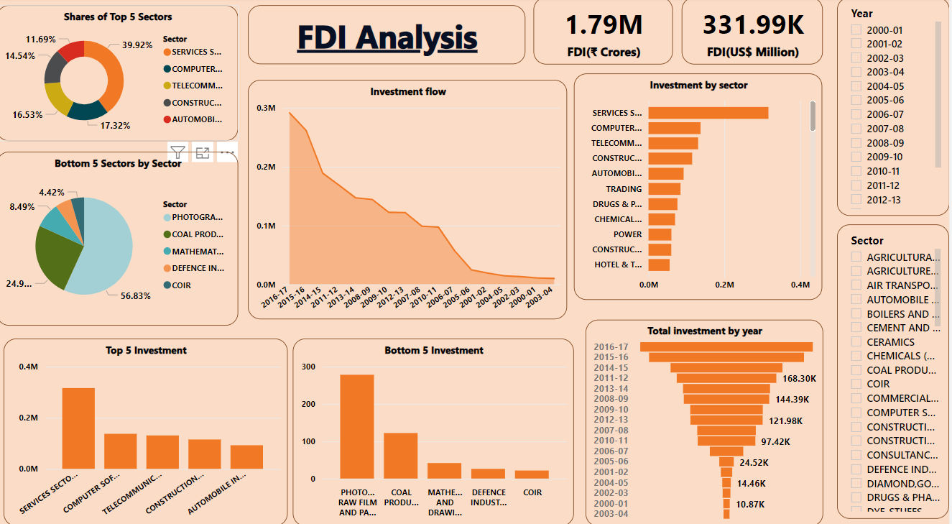
Analysis

Slide 6
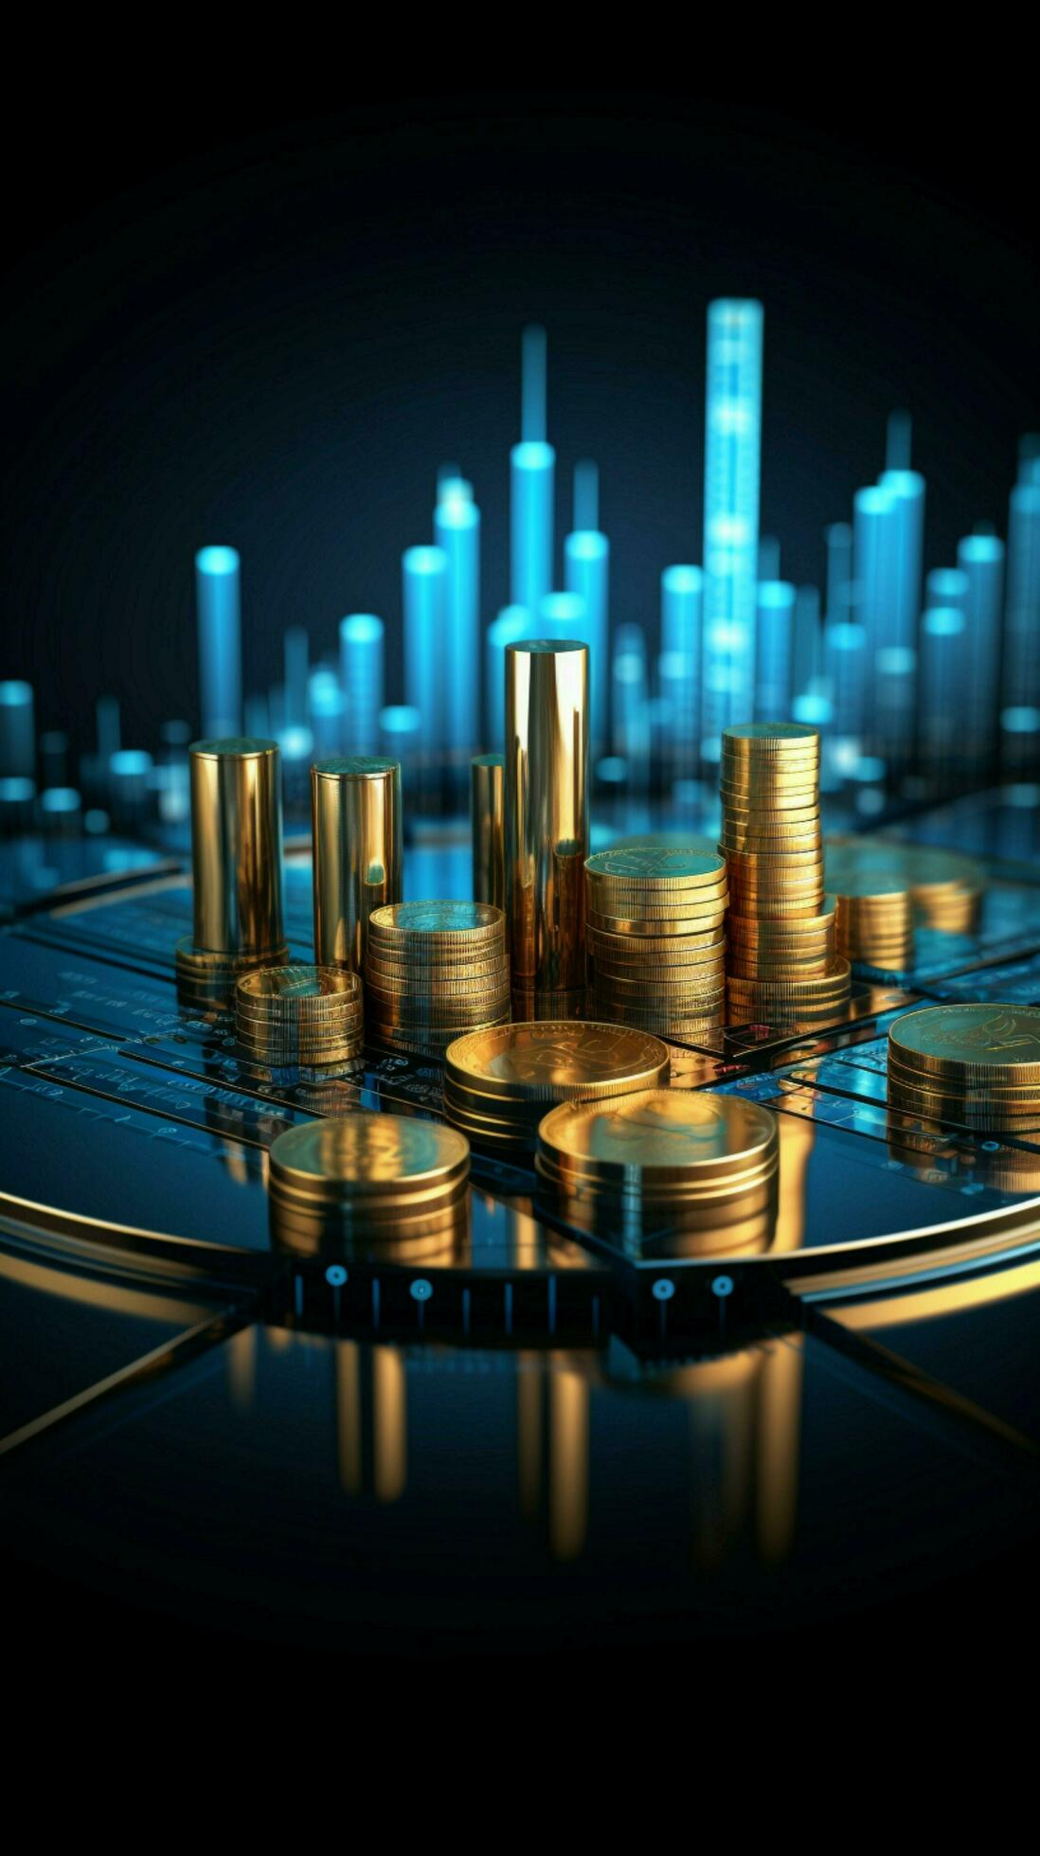
Investment by year
Year | In Crores | In USD Million
2000-2001 | 10.87K | 2.38K
2001-2002 | 19.21K | 4.03K
2002-2003 | 13.09K | 2.70K
2003-2004 | 10.05K | 2.19K
2004-2005 | 14.46K | 3.22K
2005-2006 | 24.52K | 5.54K
2006-2007 | 56.51K | 12.49K
2007-2008 | 98.94K | 24.58K
2008-2009 | 144.39K | 31.40K
2009-2010 | 122.56K | 25.83K
2010-2011 | 97.42K | 21.38K
2011-2012 | 168.30K | 35.12K
2012-2013 | 121.98K | 22.42K
2013-2014 | 147.01K | 24.30K
2014-2015 | 189.11K | 30.93K
2015-2016 | 261.85K | 40K
2016-2017 | 291.61K | 43.48K

Slide 7
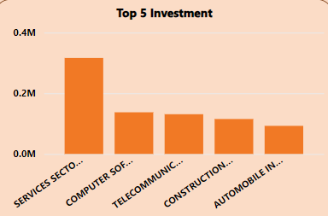
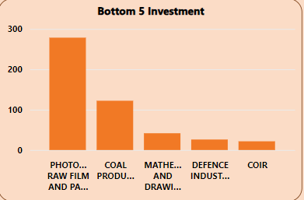
Top 5 and bottom 5 investments

Slide 8
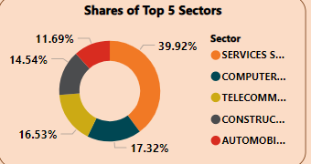
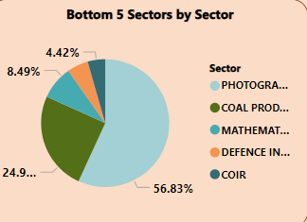
Investment by sector

Slide 9
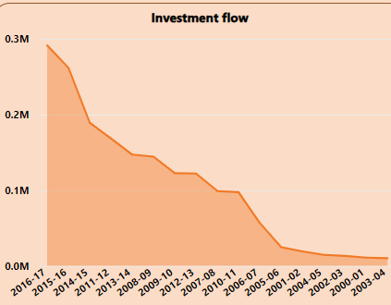
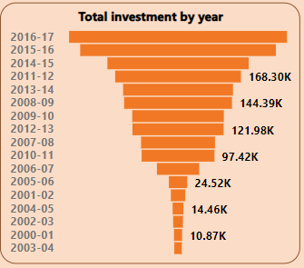
Investment Flow

Slide 10
Findings
The Service sector Managed to Attract highest FDI which was ₹ 316347.59Cr greater than any other Sector & among top 10 Sectors it has 27.7% share and among all it has 17.65%.
Among Bottom 5 sectors, Coir has the lowest FDI of ₹21.64Cr having only 4.4% share among bottom 5 sectors and among all it has only 0.001208%.
We can analysis from the graph that in the year 2011-2012 the inflow of FDI was second highest of last 15 years i.e. 168298.80.Year 2012-13 and 2013-14 the FDI inflow fluctuated from 121984.32 to 147010.90respectively. In last Financial Year i.e.2016-2017 the amount of FDI Inflow were ₹291608.67Cr which is the highest FDI inflow in last 17 years.4.The Sectoral composition of FDI over the period of April 2000 to June 2017,
we can find that the largest recipient of such investment is service sector (Financial and non-financial services). The share of this sector in FDI flows is 17 % of the inflow total foreign direct investment.
The foreign investors are interested in mainly financial services due its profit generating advantage. This sector gives scope for the foreign investor to takes back the profits to the home country. As service sector the services are consumed in the host country and there by generating outflow of funds from the host country.
The second recipient is Computer software and hardware which shares 7% of total FDI. Telecommunication,, Construction Development , Automobile industry,Trade, Drugs and pharmaceuticals, Chemical ( Other than Fertilizers),Power, Construction,Hotel and tourism contribute around 7%,6%, 5%, 4.7%, 4%, 4%, 3%, 3% . Their is very low interset towards sectors like Coir, Defence Industries, Mathematical,surveying and drawing Instruments, Coal Production and there are around 28 to 30 sectors where share is less than or equal to 1%.

Slide 11


